Slide 1

My Friends Favorite Artists!

Slide 2
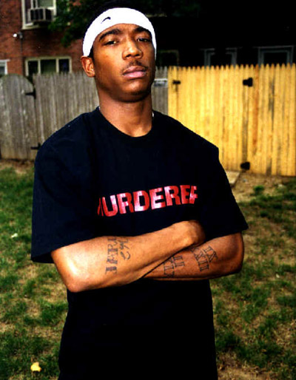
Latoya’s man
Ja rule

Slide 3
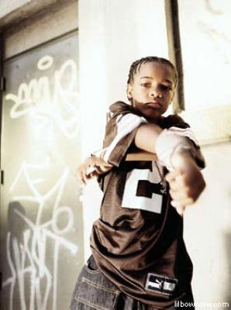
Judy’s Man
Bow Wow

Slide 4
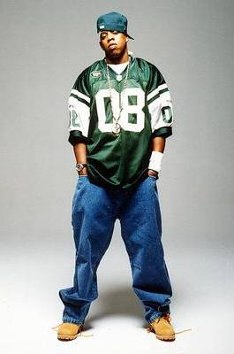
Willynn’s Man
        Jay-z

Slide 5
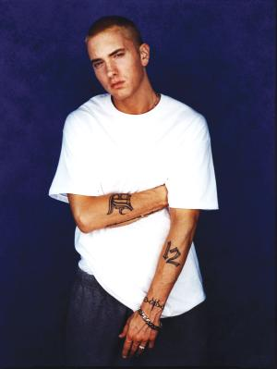
Anna’s Man
Eminem

Slide 6
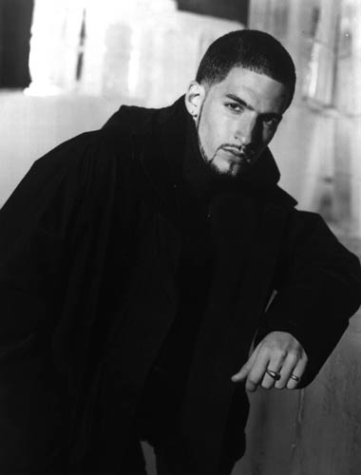
Patrice’s Man
Jon B

Slide 7
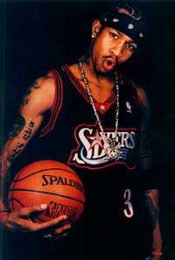
Judy
The crazy one!

Slide 8

Willynn
The quiet one !

Slide 9

Patrice
The shy one !

Slide 10

Latoya
The mean
one!

Slide 11
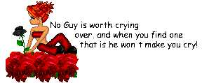
Anna
The boy lover!

Slide 12
Picture’s

Slide 13
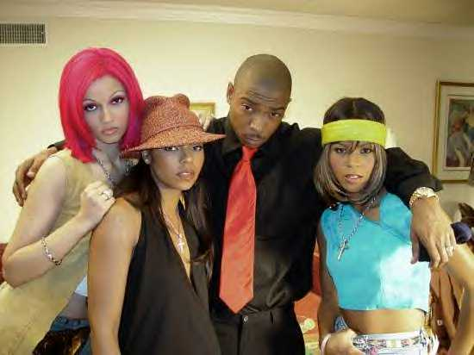

Slide 14


Slide 15


Slide 16


Slide 17


Slide 19


Slide 20


Slide 21


Slide 22


Slide 23


Slide 24


Slide 25


Slide 26
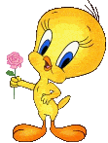

Slide 27


Slide 28


Slide 29
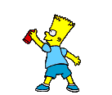

Slide 30
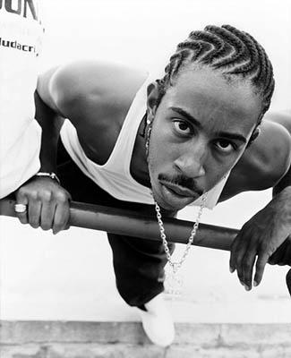
Ludacris

Slide 31
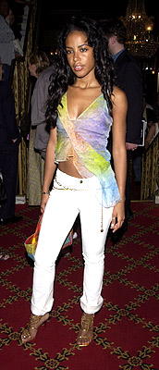
Aaliyah

Slide 32
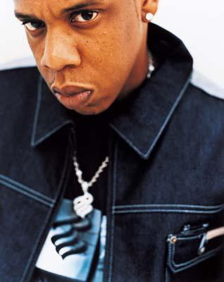
Jay-Z

Slide 33
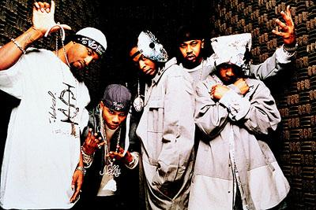
St.lunatics

Slide 34
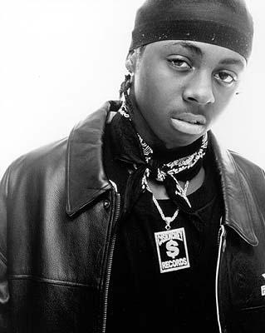
Lil’Wayne

Slide 35
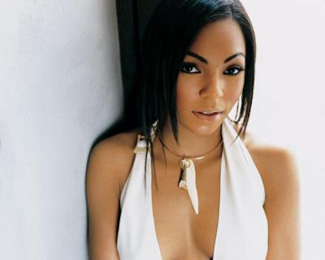
Ashanti

Slide 36
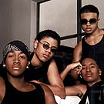
B2K

Slide 37
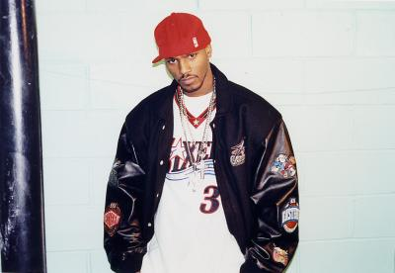
Cam’Ron

Slide 38
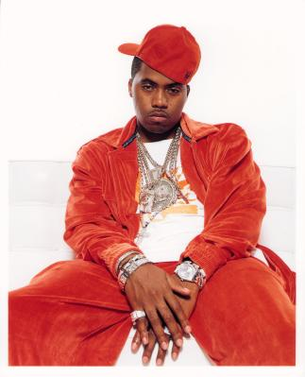
Nas

Slide 39
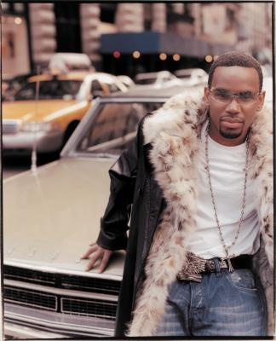
Avant

Slide 40
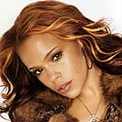
Faith Evans

Slide 41
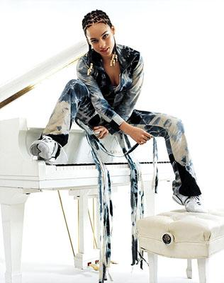
Alicia Keys

Slide 42
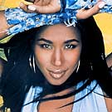
Tweet

Slide 43
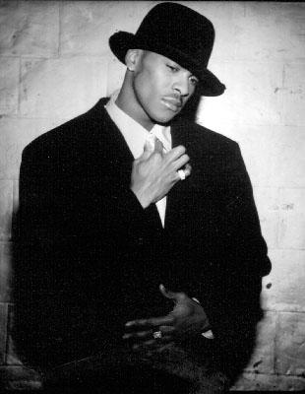
Ginuwine

Slide 44
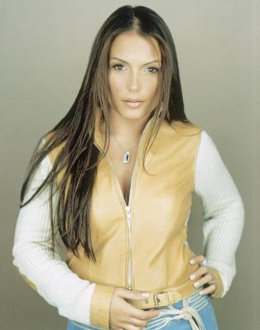
Angie Martinez

Slide 45
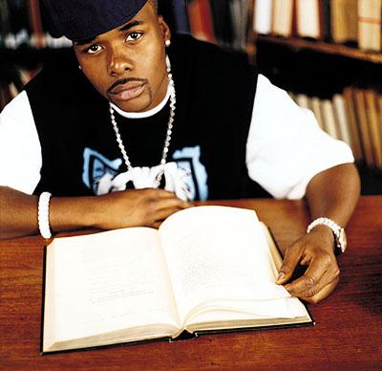
Memphis Bleek

Slide 46

And that’s the end of my slide show

